Slide 1

each-In
Upgrade Yourself

Slide 2



Meet our team
Jahangir Hossain
Mehraz Hossain Rumman
3rd Year 2nd Semester
CSE, Jagannath University, Dhaka
4th Year 2nd Semester
MATHEMATICS, Jagannath University, Dhaka
Md. Farhan Masud Shohag
3rd Year 2nd Semester
CSE, Jagannath University, Dhaka

Slide 3
Problem Definition & Validation
In today’s fast-paced world, accessing expert advice and consultation is crucial for making informed decisions and solving complex problems. However, accessibility to experts is not always easy or straightforward.
That's why, We came up with the idea of “Teach-In”.

Slide 4
Introduction
"Teach-In" is a leading educational platform (ed-tech) that is dedicated to transforming and revolutionizing the way people learn and access education. Established with a vision to make education more Accessible, Engaging, and Effective, "Teach-In" has been at the forefront of technological innovation in the education sector.

Slide 5
Solution Idea
The proposed solution to create an education platform which has the potential to be logical, practical, and applicable.
Logical:
1. Demand for online
Education.
2. Comprehensive
Learning
3. Mentorship
Practical:
1. Technology
Infrastructure
2. Accessibility
3. Scalability
Applicable:
1. Market Demand
2. Flexibility
3. Global Reach

Slide 6
Primary goals
To make education more Accessible, Engaging, and Effective.
To bind Students & Teachers in a majestic way.
15/10/2023
Teach-In
6

Slide 7
Tools & Technologies
Front-End
Back-End
React JS
Tailwind CSS (Daisy UI)
Node JS
tRPC
Database
Others
MySQL
Redis
MathJax for LaTeX Rendering
Prisma ORM
Git & Github

Slide 8
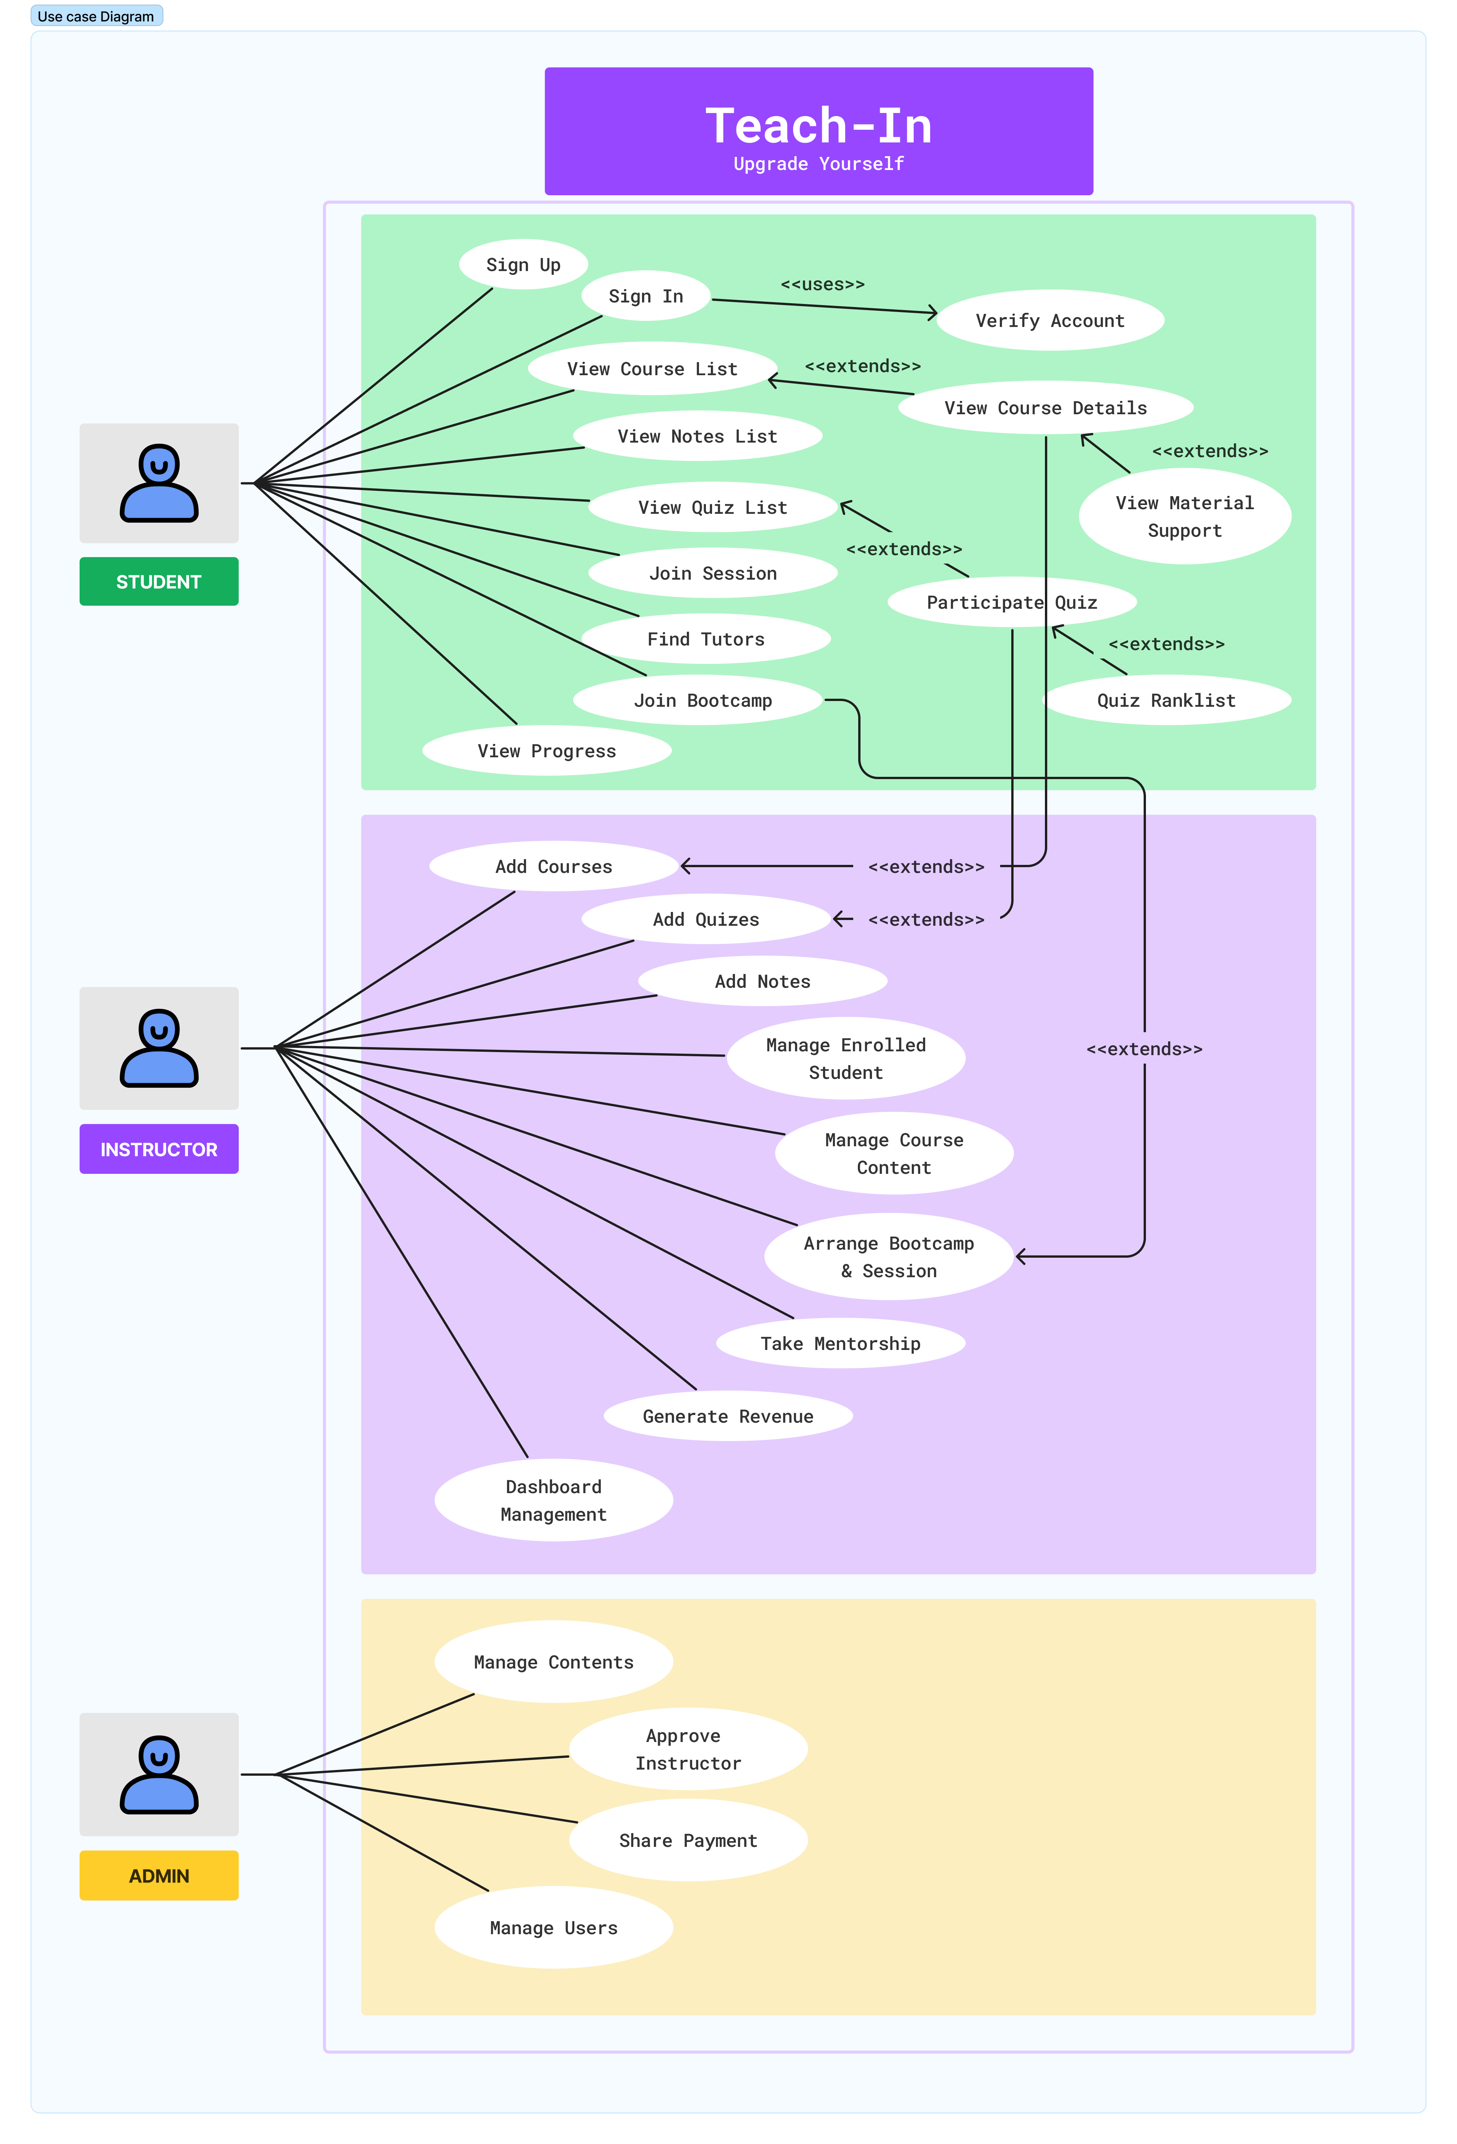
Use Case Diagram

Slide 9
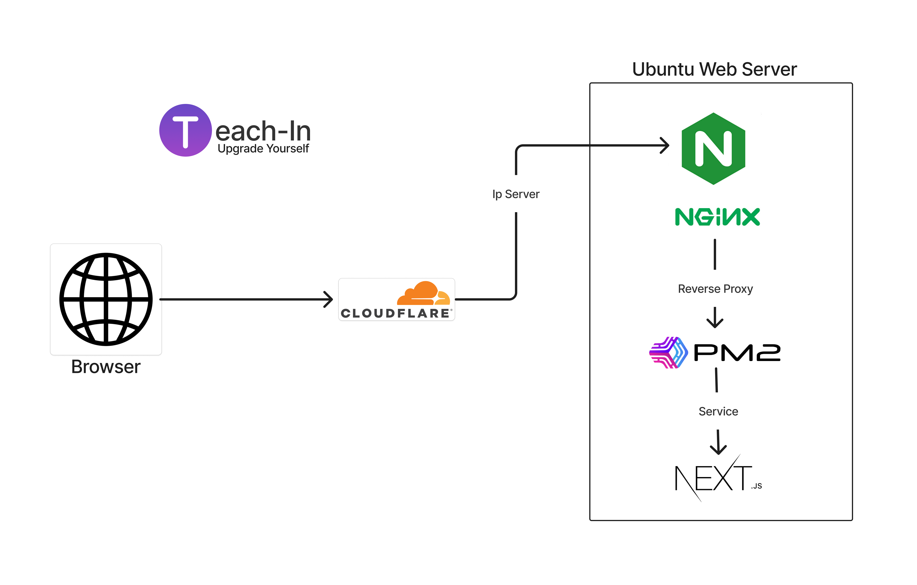
System Design

Slide 10
User Interaction
Free & Paid PDF notes from us
Quiz Contest
Courses
Enroll Courses, Rate & Review them
AI Chat bot
Play quizzes from AI generated questions & Images
Rating based on results & Prizes for top performer
Notes
Leaderboard
Weekly/Monthly Contest on Various Topic
1
2
3
4
5

Slide 11
Features
Online Classes (pre-recorded)
Live Classes
Chat & Discussion forums
Student Review & Rating
Assessment & Quizzes
Progress Tracking
Certification & Badges
Personalized Learning Paths
Analytics & Reporting Performance
Resource Library
Parent/Teacher Communication
AI-Powered Recommendation
Feedback Mechanism
Accessibility Features

Slide 12
User Interface
For Students
15/10/2023
Teach-In
12

Slide 13
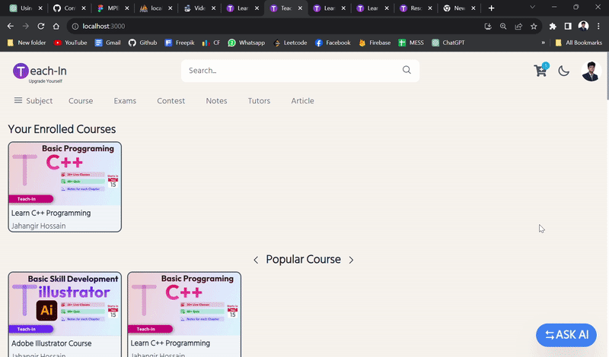
Snap Shots: Home Page

Slide 14
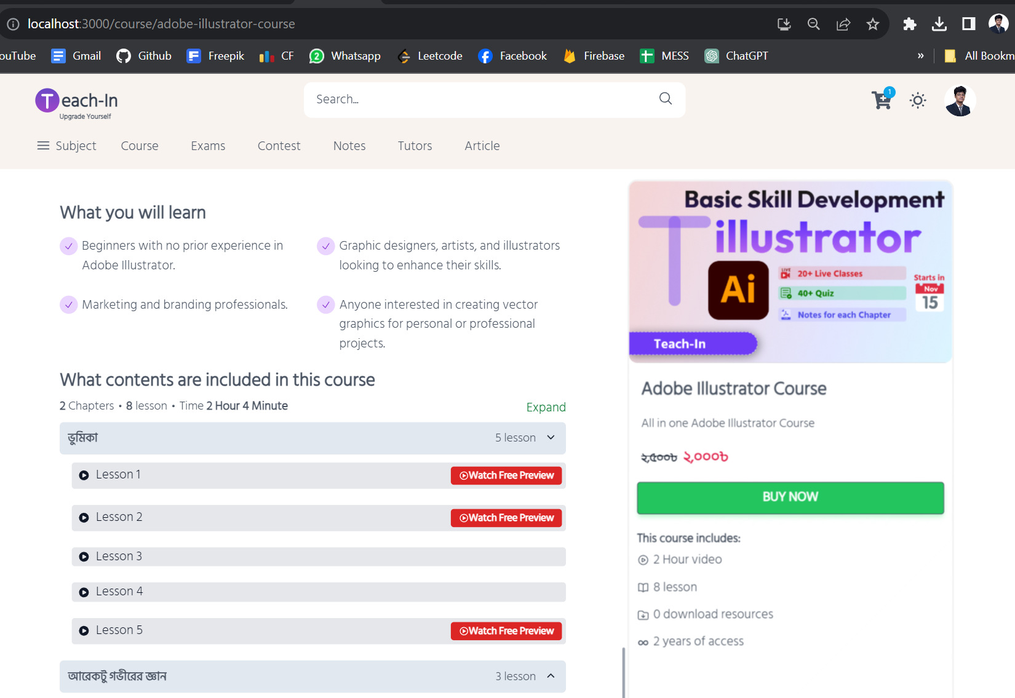
Snap Shots: Course Details

Slide 15
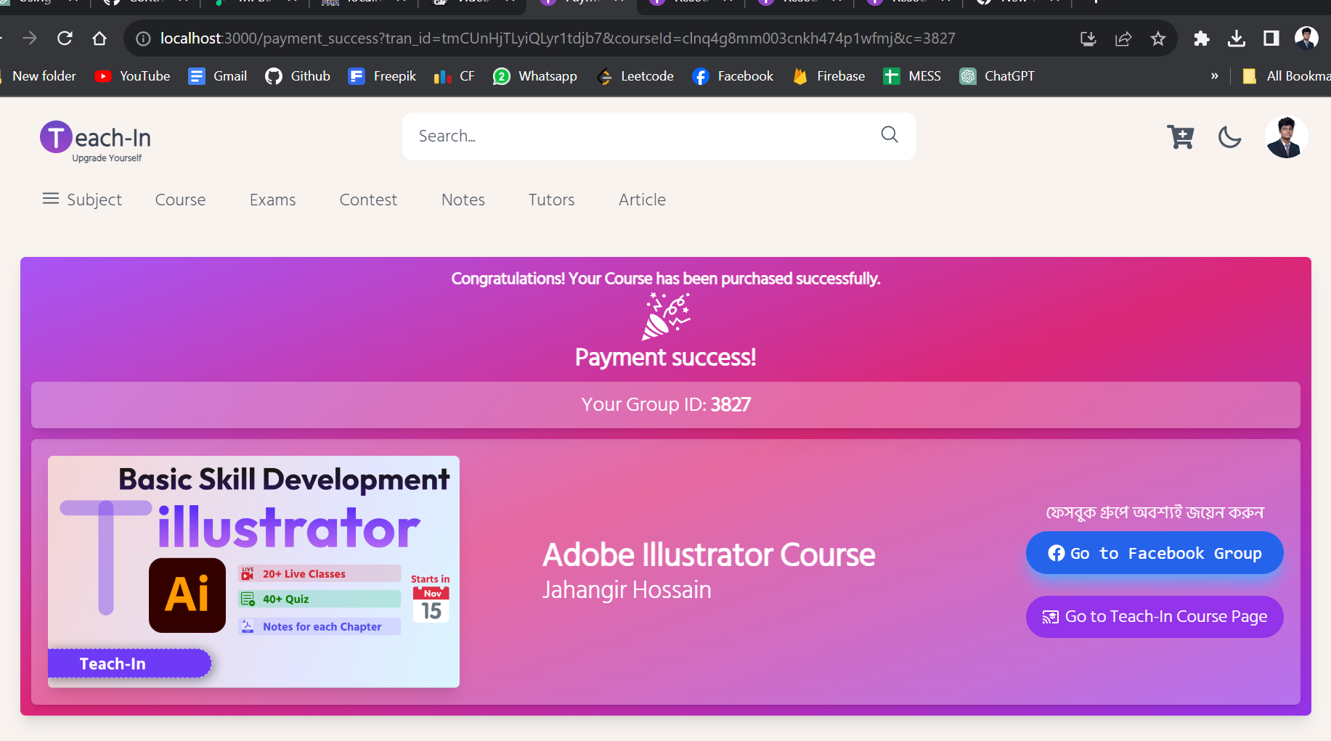
Snap Shots: Course Enrollment

Slide 16
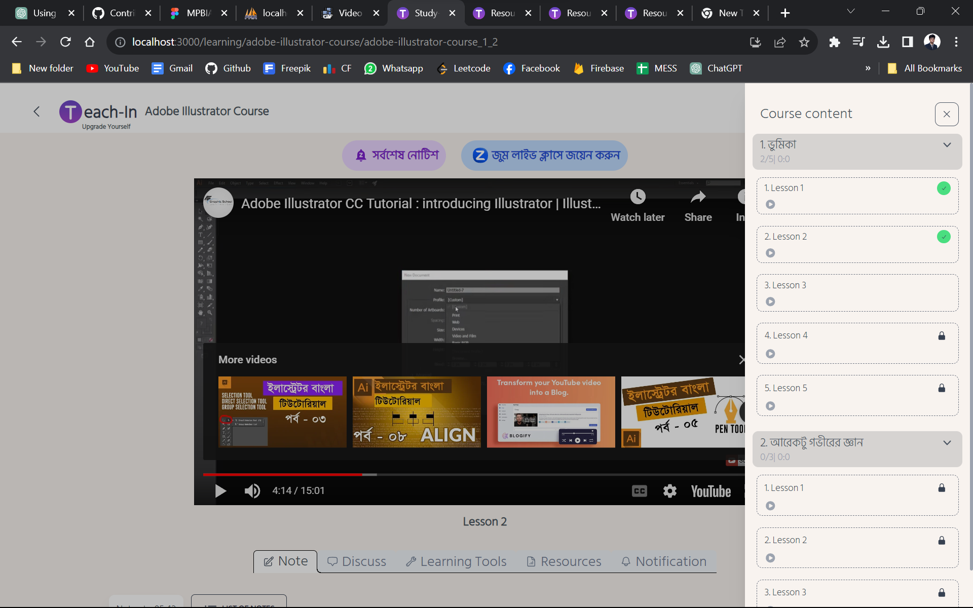
Snap Shots: Course Content

Slide 17
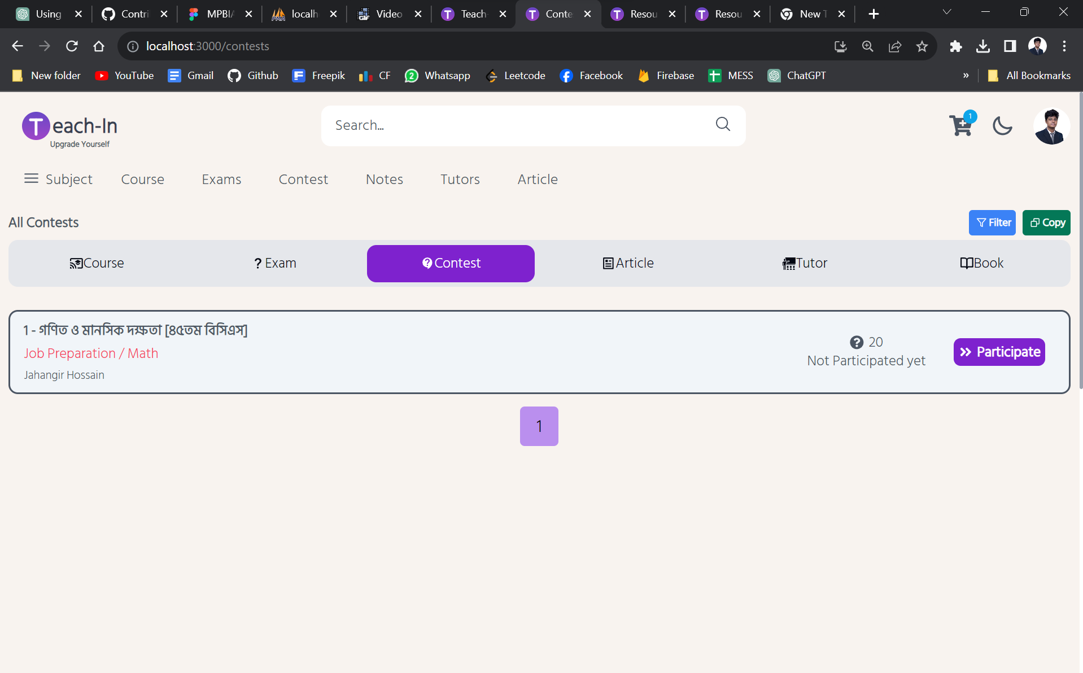
Snap Shots: Running Quiz Contest

Slide 18
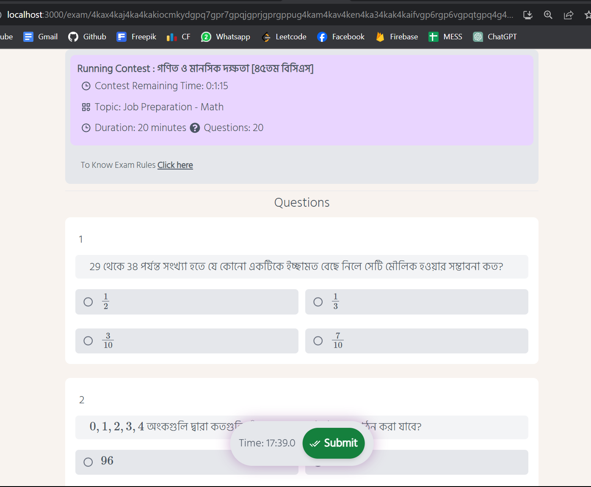
Snap Shots: Running Contest’s Page

Slide 19
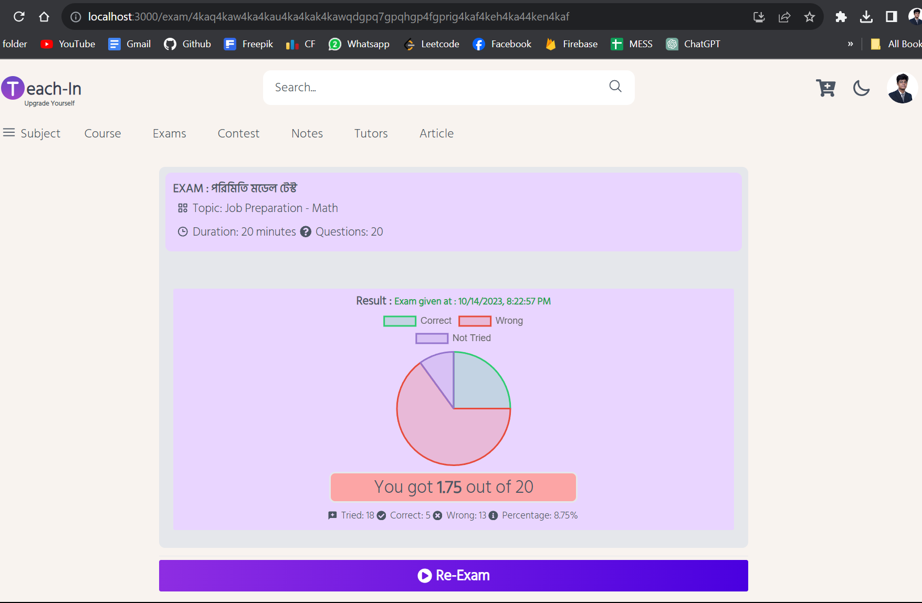
Snap Shots: Quiz Result

Slide 20
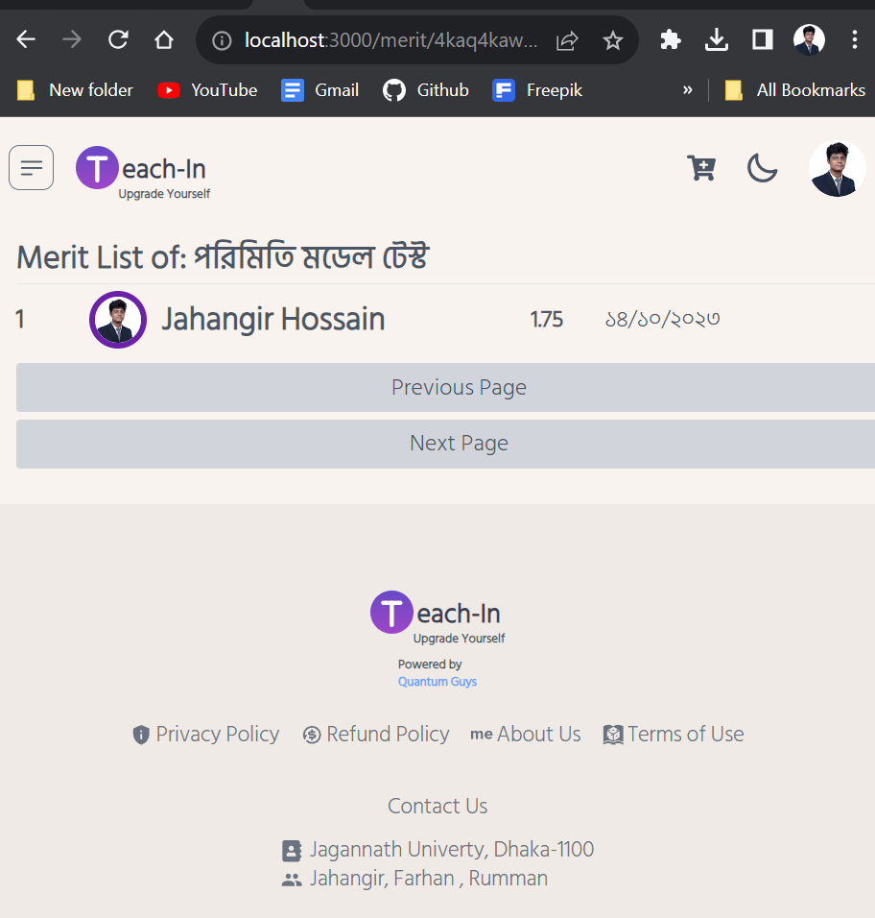
Snap Shots: Merit List/ Leaderboard

Slide 21
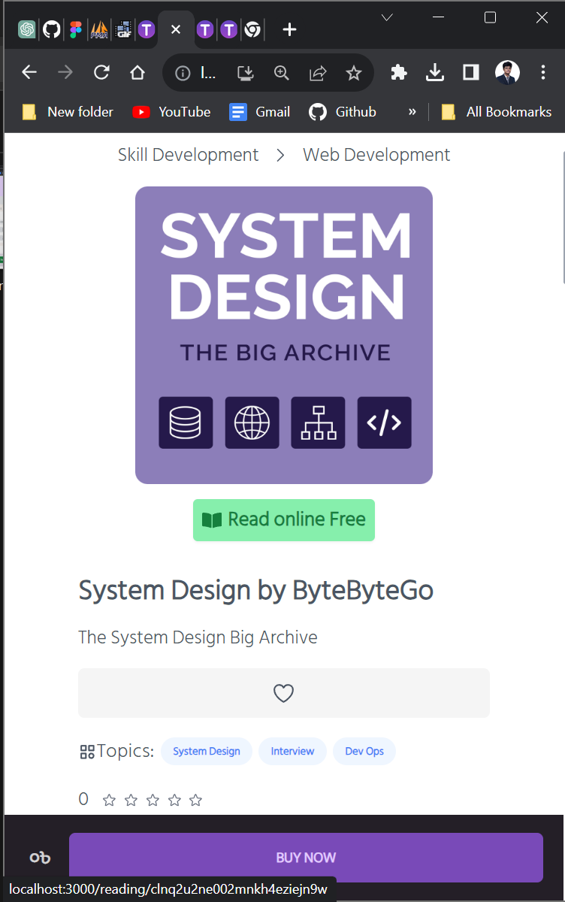
Snap Shots: Note’s Details

Slide 22
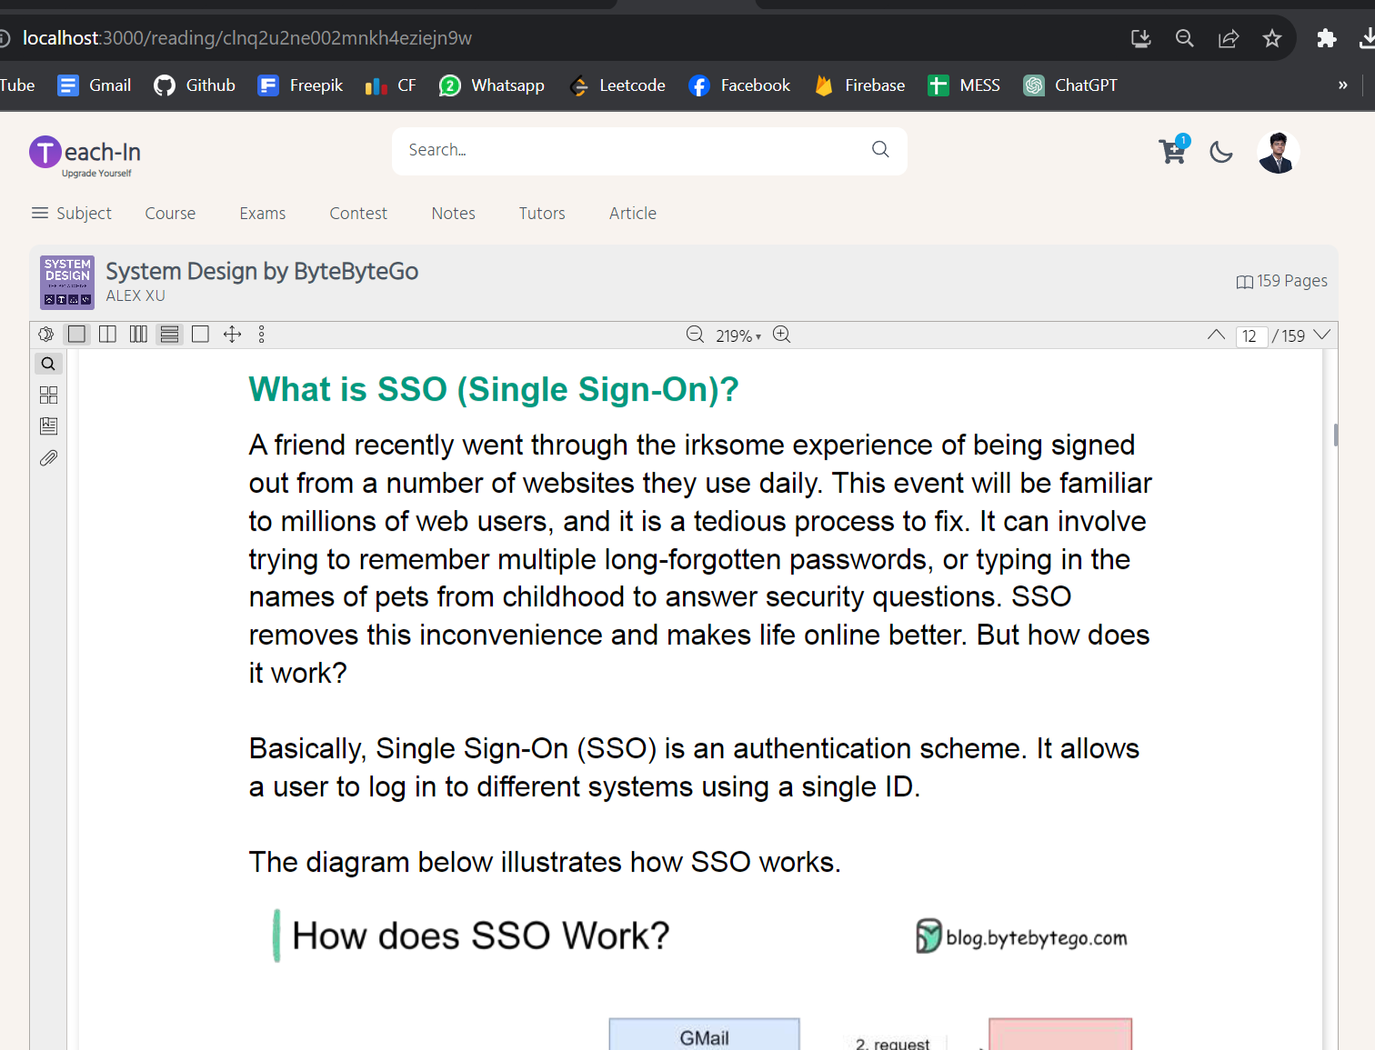
Snap Shots: Online Reading Page

Slide 23
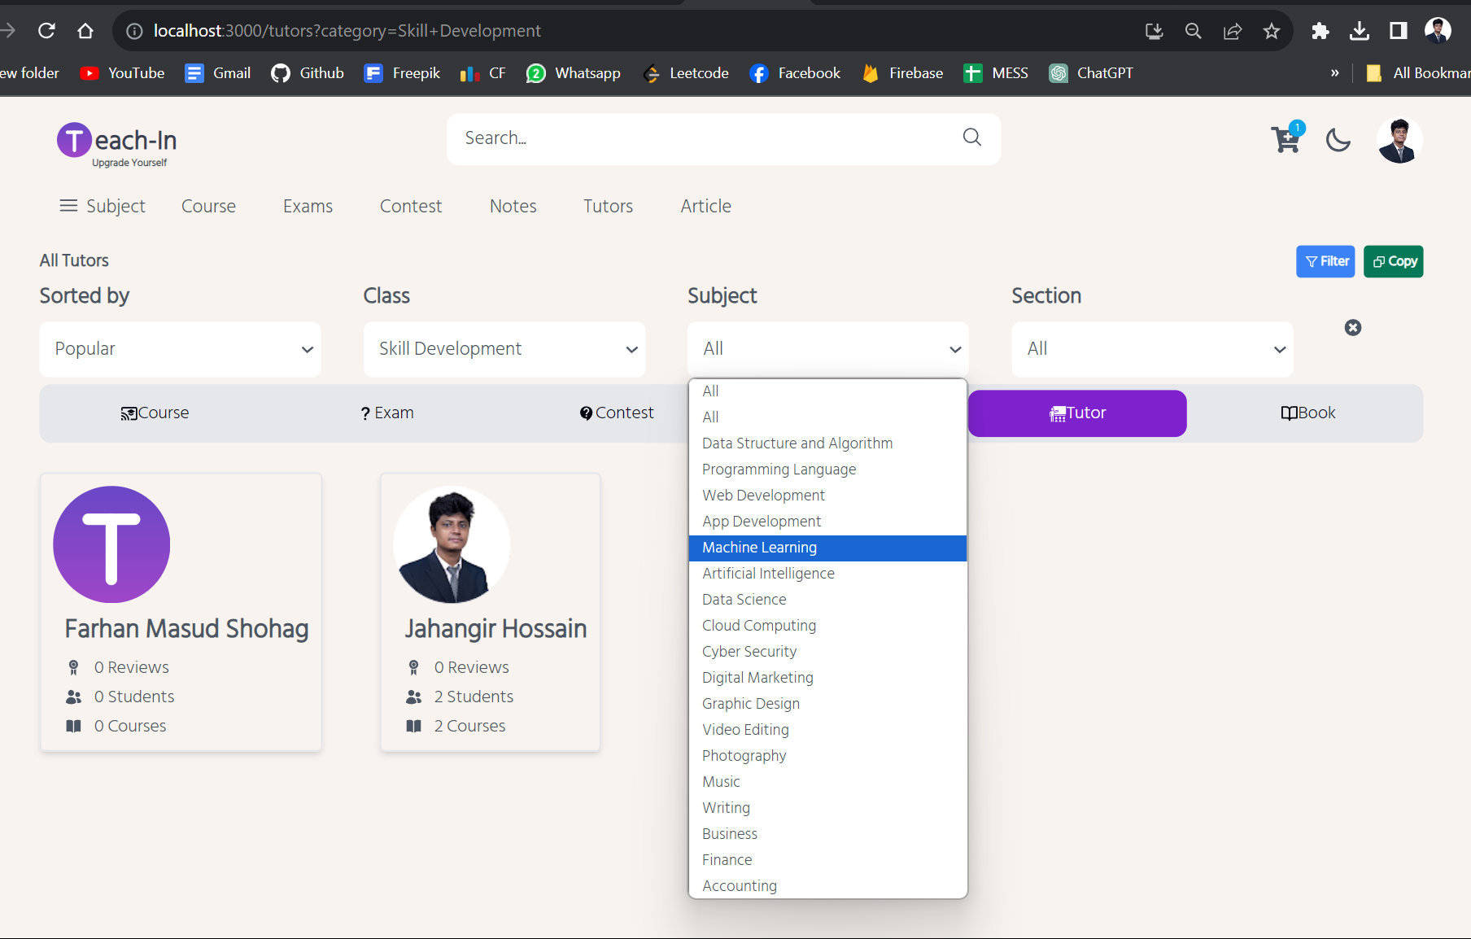
Snap Shots: Find Tutor with Filter Search

Slide 24
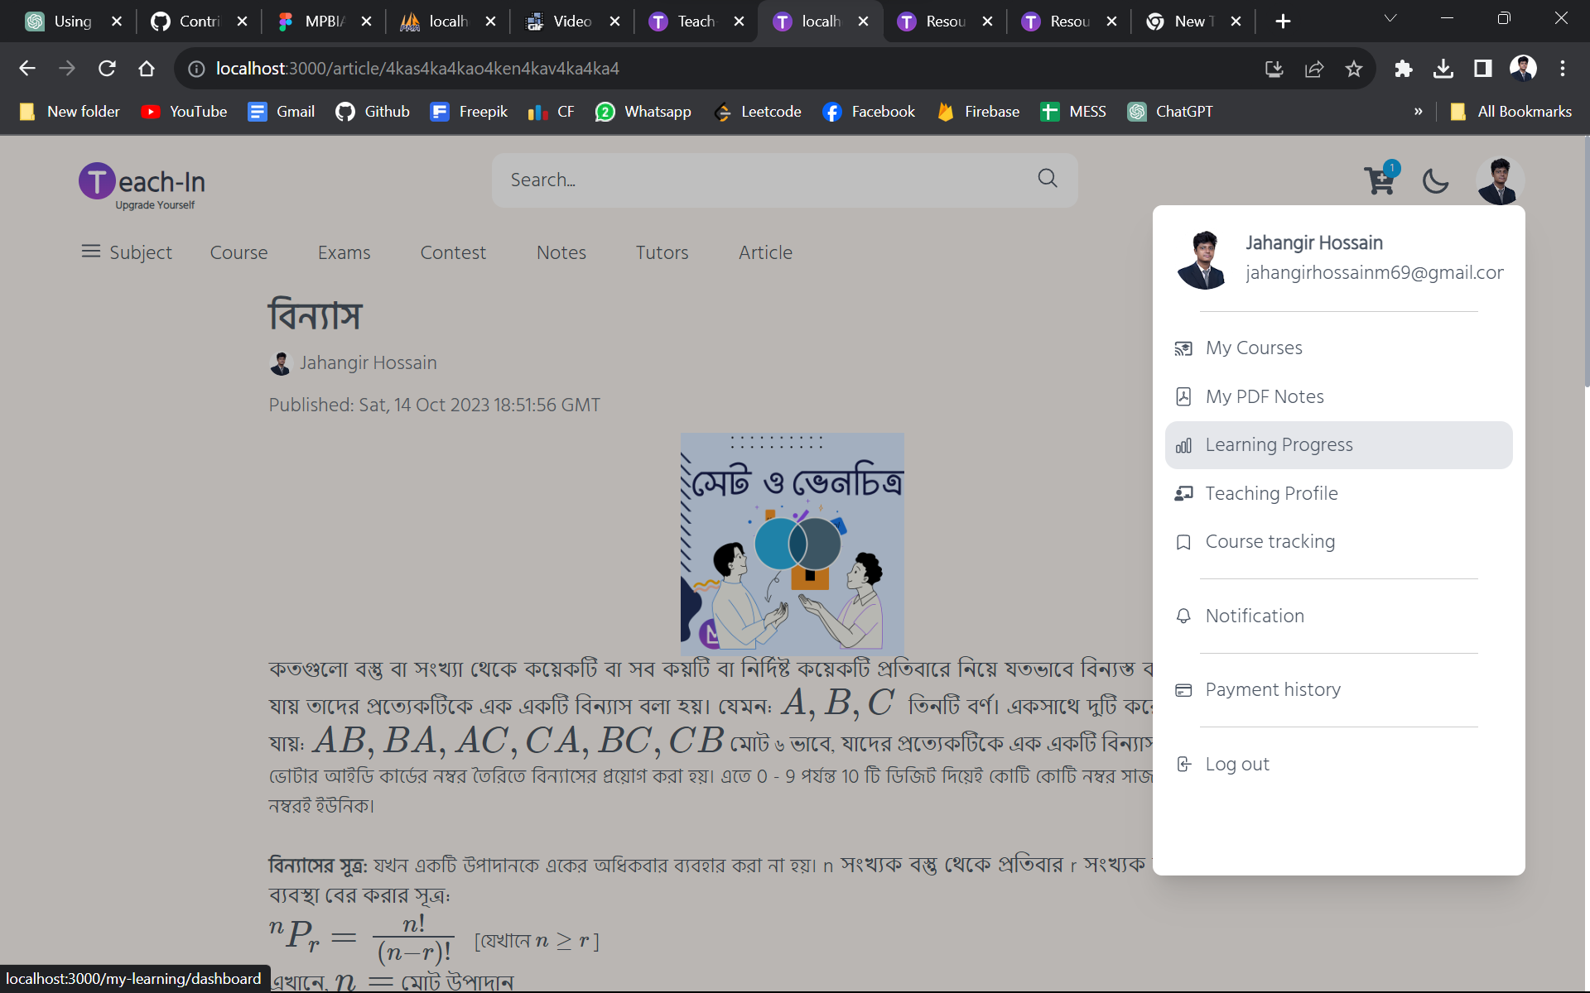
Snap Shots: Articles & Profile Menu

Slide 25
User Interface
For Teachers
15/10/2023
Teach-In
25

Slide 26
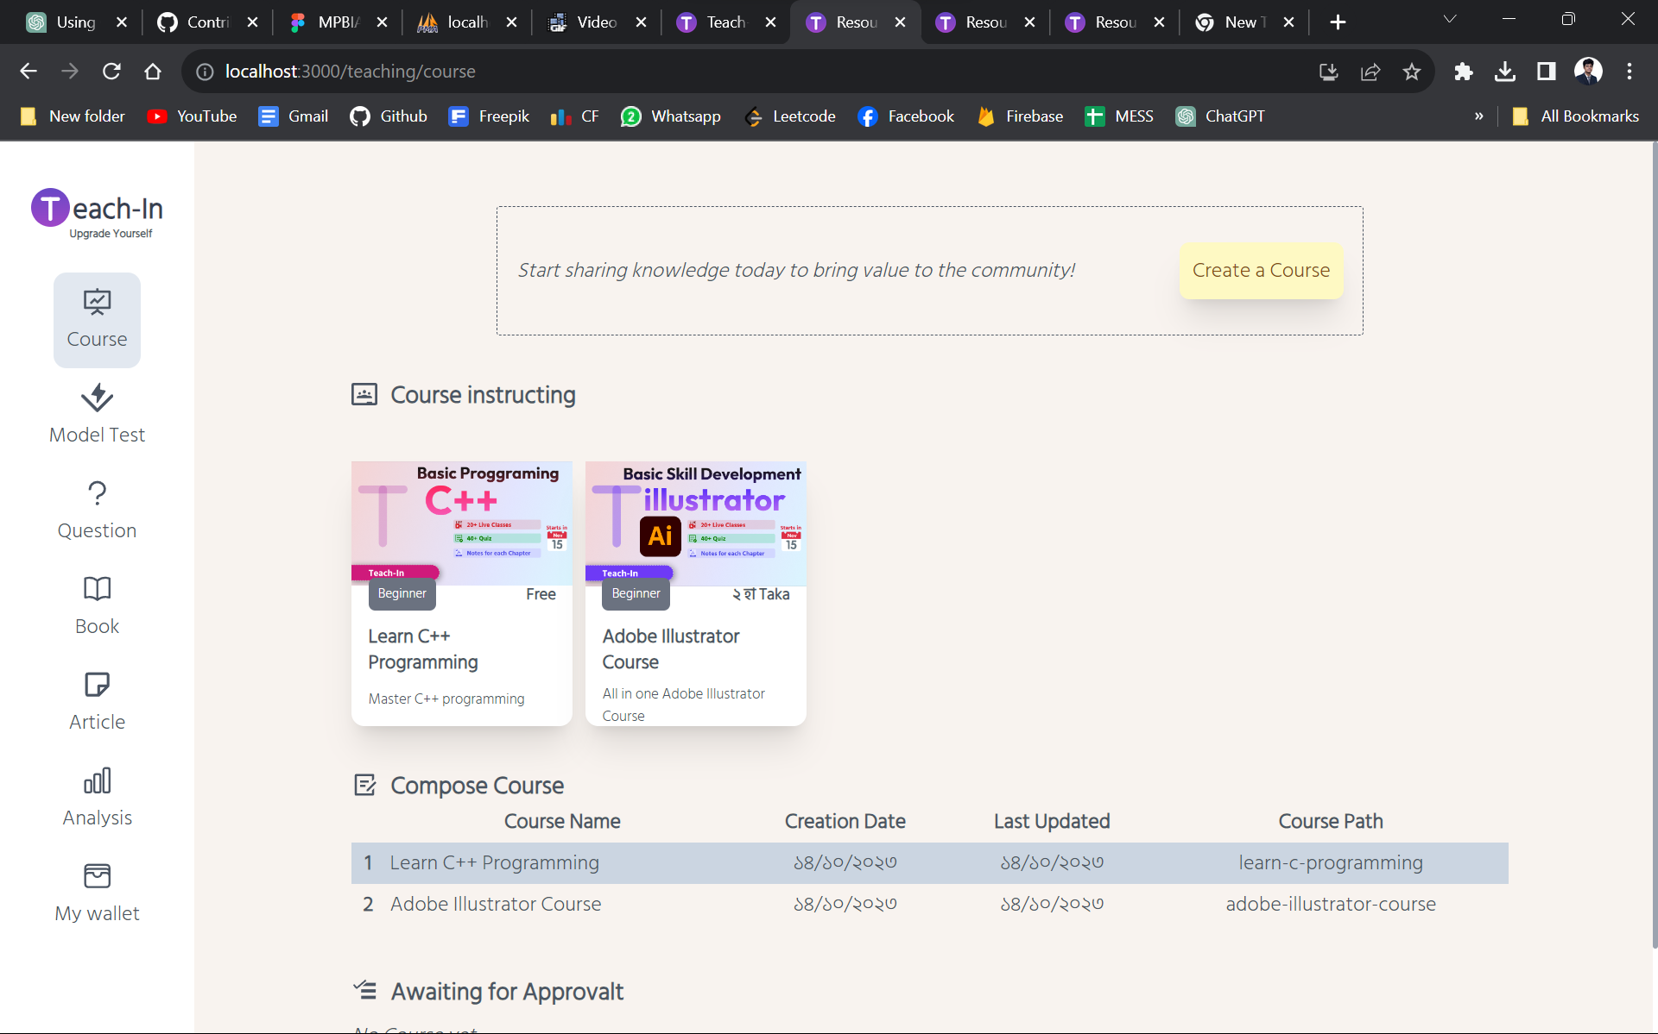
Snap Shots: Teacher’s Course Dashboard

Slide 27
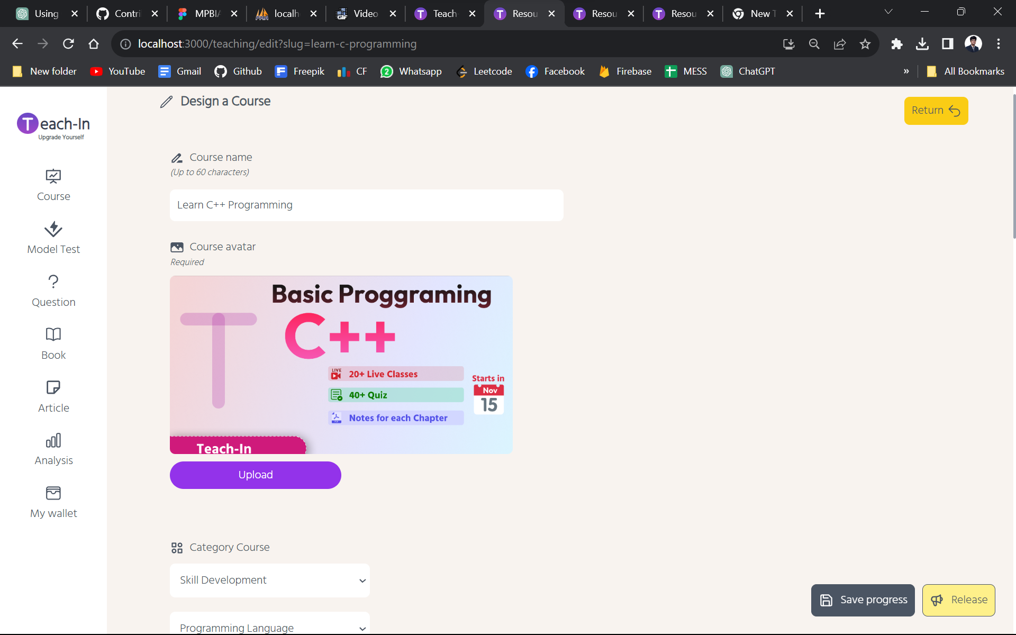
Snap Shots: Add Course

Slide 28
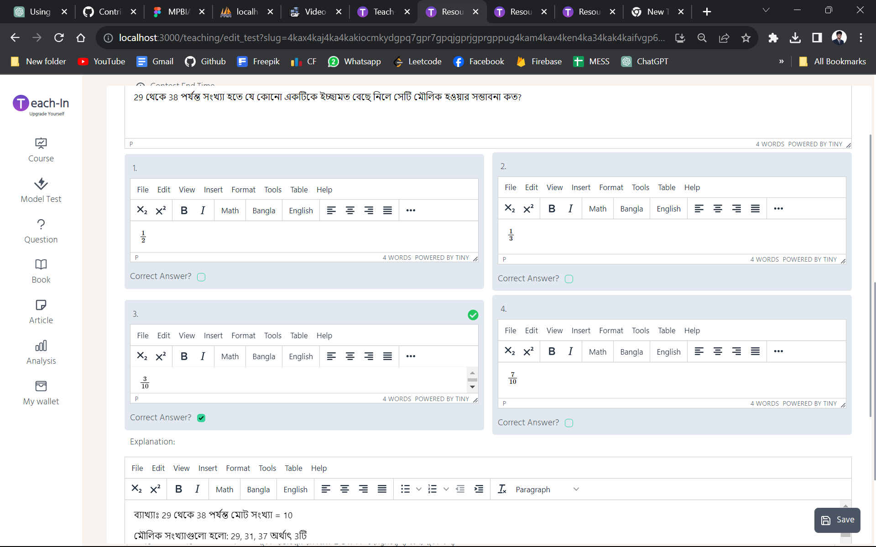
Snap Shots: Add contest’s quiz

Slide 29
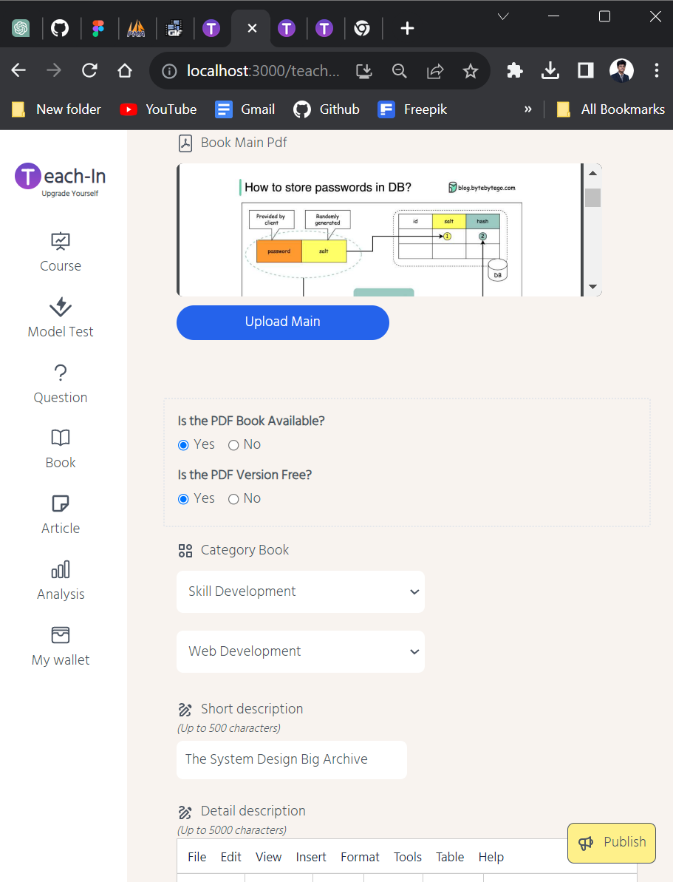
Snap Shots: Add Note

Slide 30
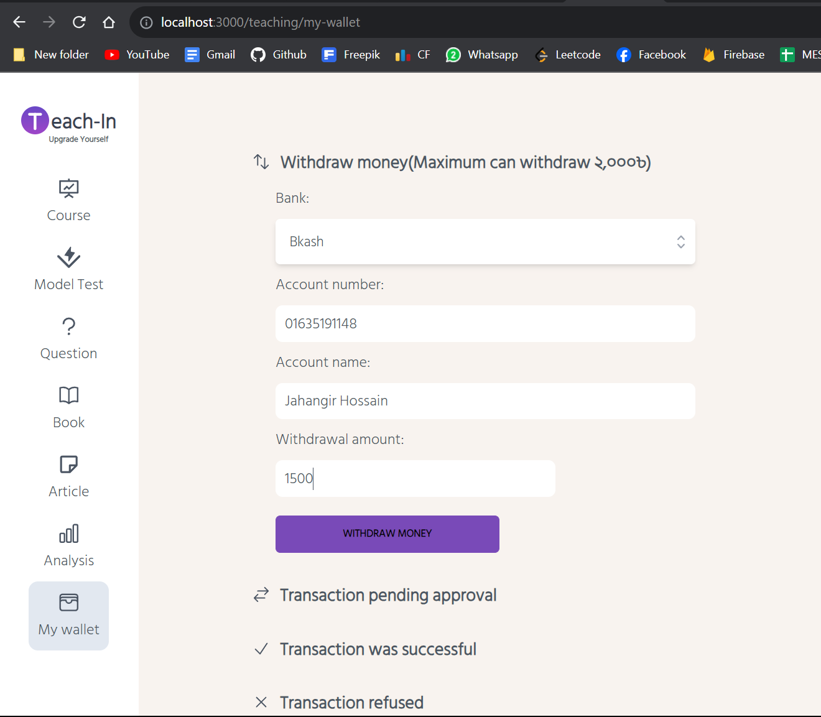
Snap Shots: Payment Request to Admin

Slide 31
User Interface
For Admin
15/10/2023
Teach-In
31

Slide 32
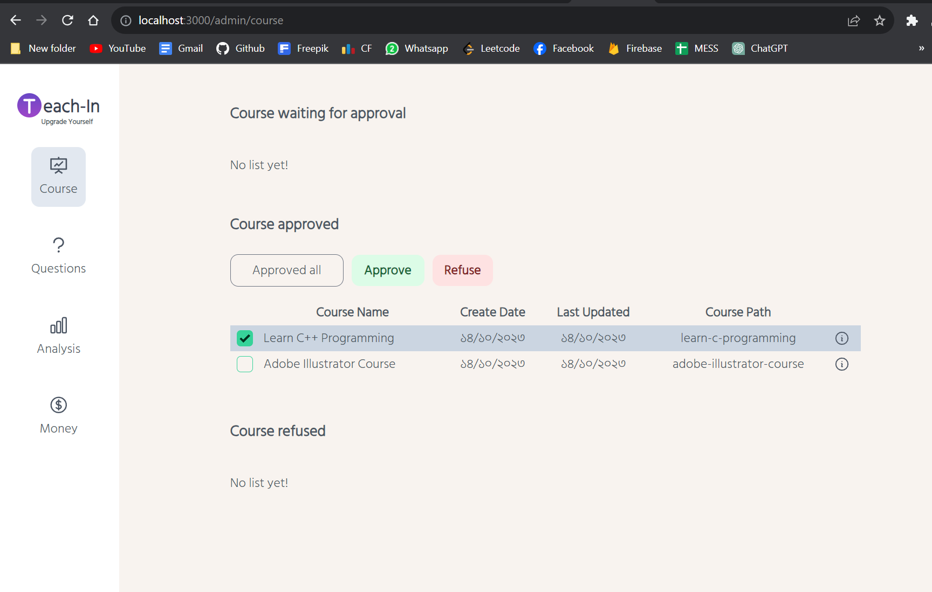
Snap Shots: Course Approval

Slide 33
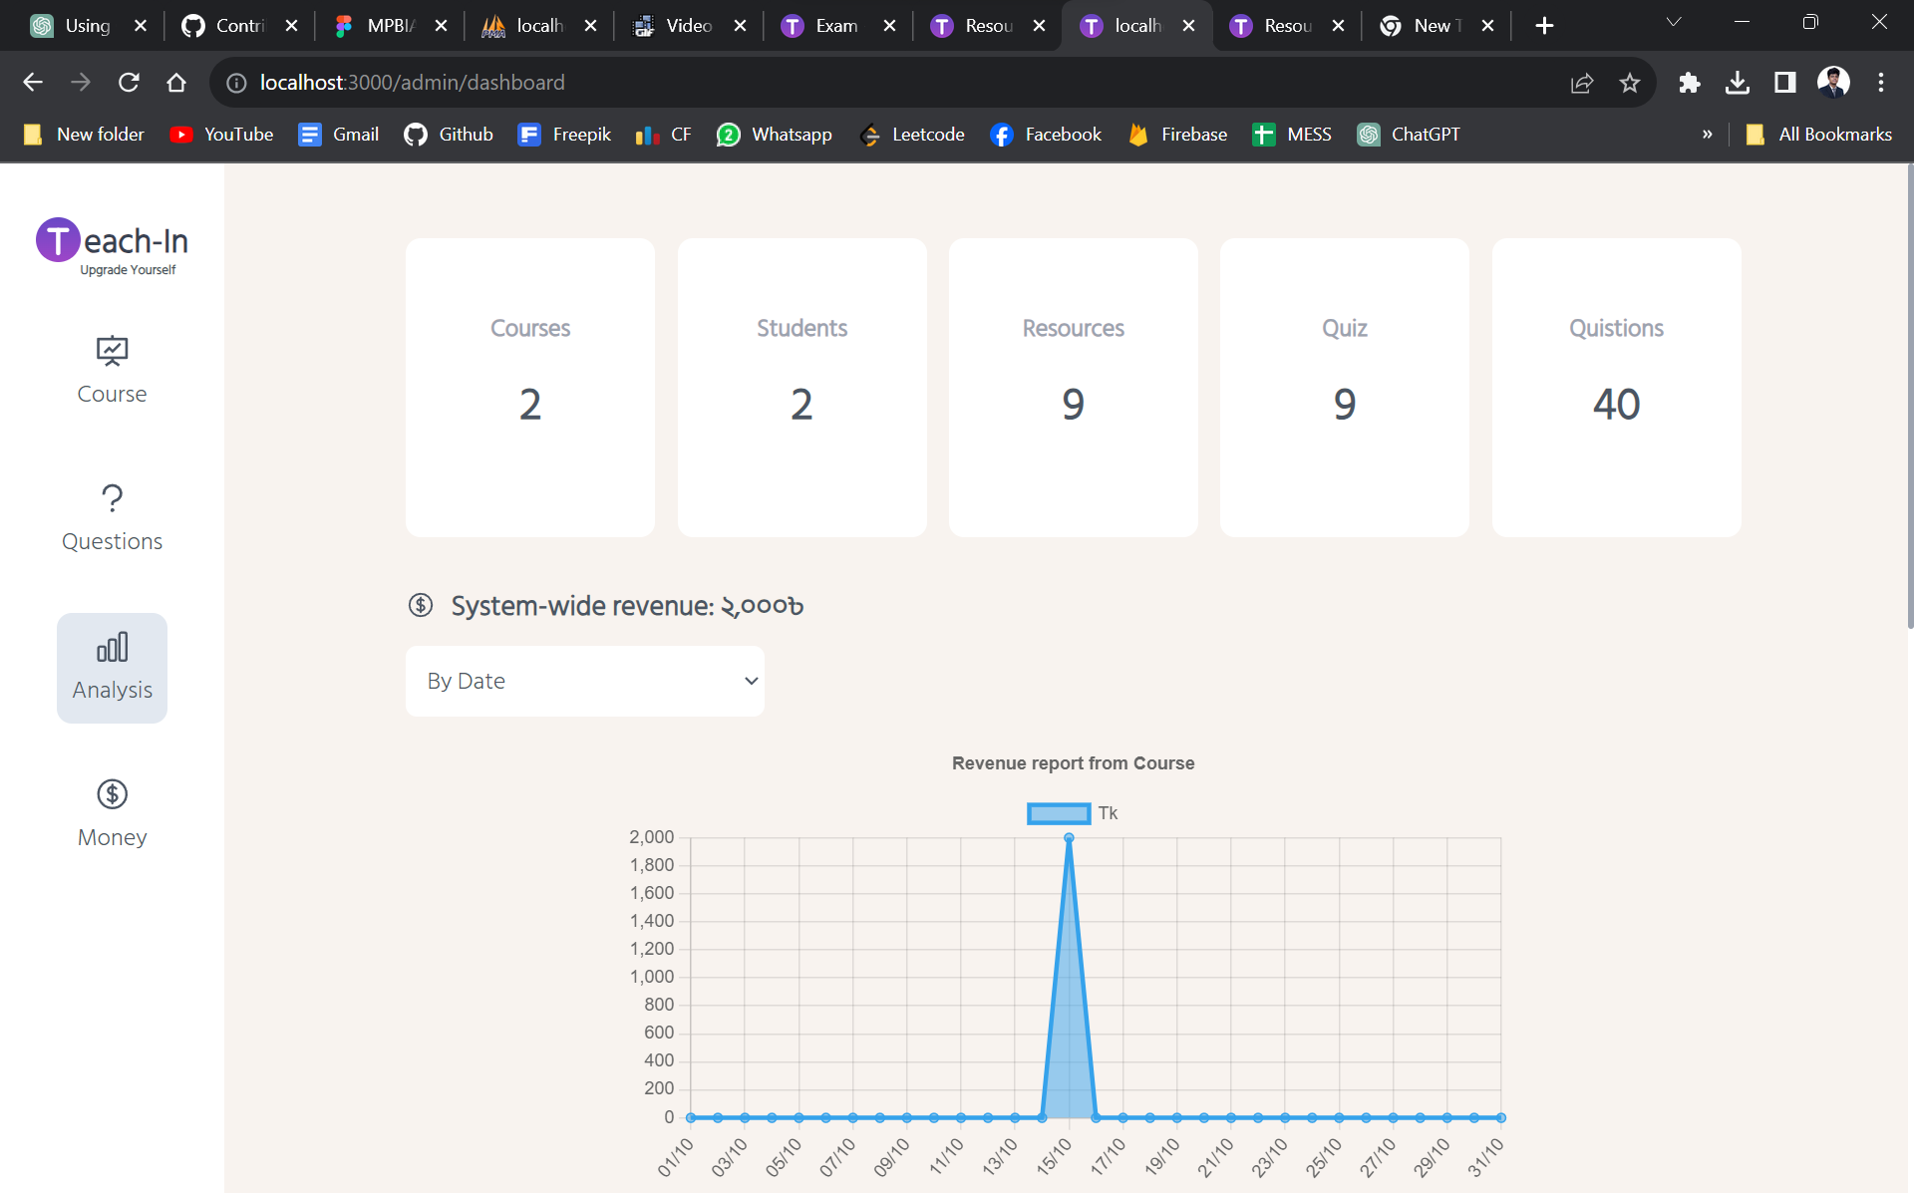
Snap Shots: Content Management

Slide 34
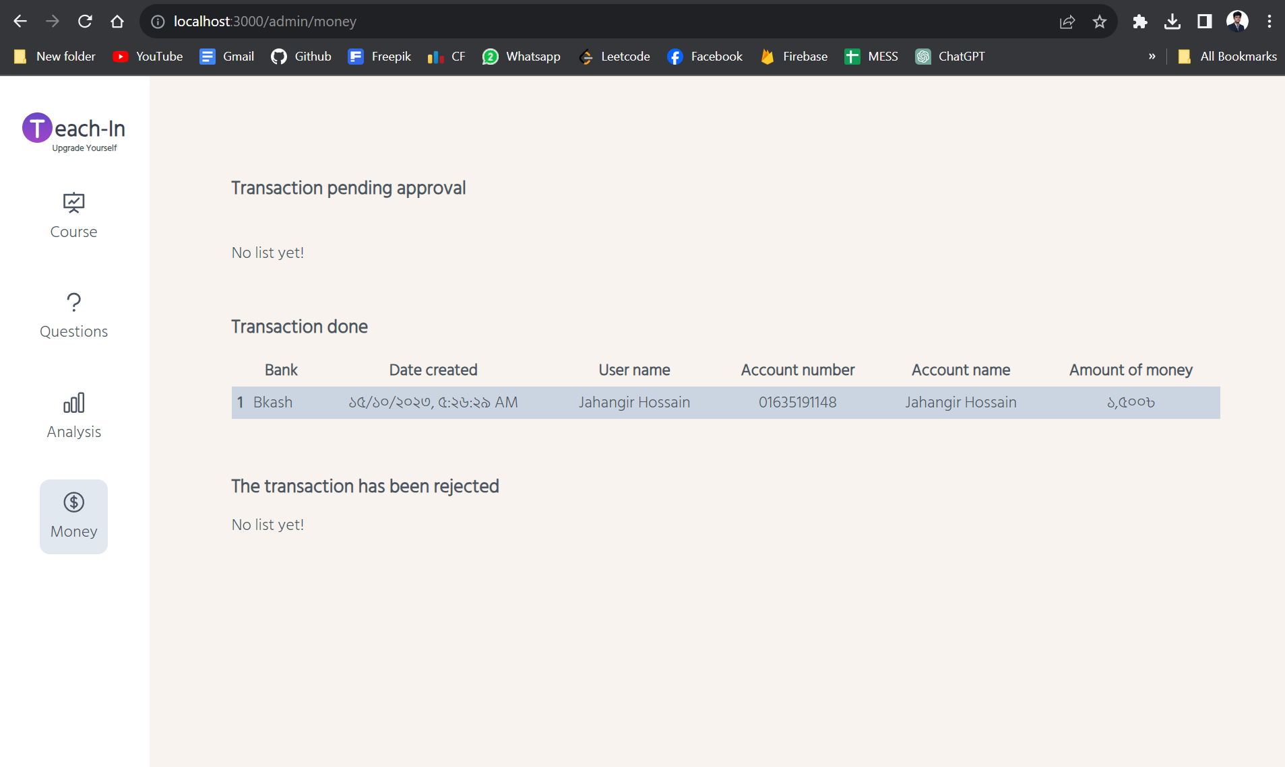
Snap Shots: Approve Payment Request

Slide 35
Revenue Model (est.)
 | 1st Year | 2nd Year | 3rd Year | 4th Year | 5th Year
Number of Courses Sold (est.) | 1000+ | 2500+ | 6000+ | 9000+ | 13000+
Average Selling Price (est.) | 800 tk | 1000 tk | 1200 tk | 1400 tk | 1600 tk
Revenue Per Course | 5% | 7% | 8% | 8.5% | 9%
Profit (est.) | 40,000 tk | 1,75,000 tk | 5,76,000 tk | 10,71,000 tk | 18,72,000 tk

Slide 36
Summary
At “Teach-In”, we believe we can revolutionize learning through data-driven agility and a visionary team. Our mission is to transform education, optimizing efficiency and embracing innovation.

Slide 37
Thank you
Let’s Create Education boundless!

